Slide 1
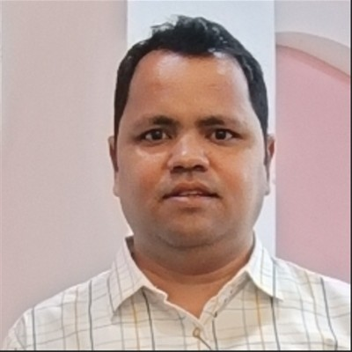
PROFILE
Azure Cloud-Native Solution Architect .NET Core, Microservices, event-driven architectures, API First, AKS, Terraform & PAAS approach.
Azure Compute, Storage, Network, Security, Operation, Confluence, Well architecture Framework, Landing zone, Strategy Evaluator etc.
Strategic Solution Architect, leveraging TOGAF ADM principles to align IT architectures with business objectives to structured digital transformation
Work with business stakeholders to understand their requirements and translate them into technical solutions.
AI-powered automation innovator, integrating Azure OpenAI, AI Search, Cloud Foundry, Azure function & Multiple Agent.
Migration and Modernization legacy application to Azure cloud native.
Compliance and security, embedding Zero Trust, Azure Key Vault, ADB2C, RBAC, and regulatory policies etc.
Have worked on API-first and event-driven architectures using Kafka Confluence, Event Grid, Service Bus, Event hub and Pub/Sub
Performance optimization specialist with runtime monitoring, anomaly detection, and observability tools
Knowledgeable in enterprise architecture modeling, using structured methodologies for IT governance
DevSecOps practitioner, driving secure, automated deployments with Terraform and Git Operations.
Leader and mentor, guiding teams on cloud-native best practices and API security governance
Digital transformation strategist focused on modernizing regulated industries like finance and insurance
Customer-centric solution designer ensuring business alignment and operational resilience
Cloud Management utilizing RBAC, Azure Blueprints and Policies, Cost Management, Monitor and alerting.
Rajneesh Prakash Hajela
Solution Architect
Solution Architecture & Design
(Enterprise frameworks, governance, consulting.)
Retail eCommerce & Cloud Modernization (Scalable AI-driven commerce solutions.)
KEY PROJECTS AND ACHIEVEMENTS
Integration & Migration Strategies
(API-first, microservices, and cloud transformation)
Led the migration from monolithic to Azure cloud-native microservices, improving system agility by and reducing infrastructure costs.
Established a multi-layered security framework, embedding Zero Trust, RBAC, and regulatory compliance standards.
Integrated Azure OpenAI and Cognitive Search, automating workflows and reducing manual effort by leading to higher operational efficiency.
Developed predictive analytics models, enabling faster decision-making and improving risk mitigation strategies.
Designed Azure API Management solutions, securing scalable integrations across enterprise applications.
Implemented event-driven architectures using Kafka, Azure Service Bus, and Event Grid, enhancing real-time responsiveness and system resilience and have worked on NO SQL like MongoDB, Cosmos DB, Azure SQL Database
Enhanced runtime monitoring and anomaly detection, ensuring faster resolution of system issues.
Developed architecture roadmaps for regulated industries, driving modernization across Retail and insurance sectors.
API security governance, AI automation, and cloud-native best practices.Discover & Design using Azure Migrate, Azure Advisor , Azure Security Center, Azure Blueprints, Cloud Adoption Strategy Evaluator, Well-Architected Framework, Azure Landing Zones.
Applied .NET Core microservices and event-driven architecture (EDA) principles for modular scalability and Well architecture framework Reliability, Security, Cost, Performance & Operation.
DevSecOps Continuous Integration and Continuous Delivery, Blue Green deployments, Code quality checks, Unit and Integration tests, Software Composition Analysis, vulnerability assessments and remediation
General Insurance & Risk Compliance (Underwriting workflows, security, and automation.)
Stakeholder & Team Leadership
Microservices & Event-Driven Architecture (Scalable design for high-availability applications.)
AI & Automation in Enterprise Workflows
(AI-driven predictive analytics and anomaly detection.)
Cloud Governance & Security Compliance
API Management & Data Strategy (Secure API ecosystems and real-time data processing.)
Technology Evaluation Landscape Assessment (Strategic planning for IT modernization.)
Gen AI
(.NET Azure Cloud Solution)
QUALIFICATIONS
Master of Science (Information Technology) from Jiwaji University, 2004.
Bachelor Of Science(Computer Science) from Jiwaji University, 2002
Azure Cloud Solution Architect
Microsoft Certified
TOGAF, Prince 2
1

